Slide 1
Course Code: CSC211A Course Title: Formal Languages and Automata Theory
Lecture 17: Parser
Course Leader:
Prakash P
prakashp.cs.et@msruas.ac.in

Slide 2
Session Objectives
At the end of this session, student will be able to
Understand compiler concepts
Explain Parser
Understand time complexity of exhaustive search
Describe S-grammars

Slide 3
Session Topics
Compiler
ParserTime complexity of Exhaustive Search
S-grammars

Slide 4
Compiler
Machine Code
Program
Add v,v,0
cmp v,5
jmplt ELSE
THEN:
add x, 12,v
ELSE:
WHILE:
cmp x,3
...
v = 5;
if (v>5)
x = 12 + v;
while (x !=3) {
x = x - 3;
v = 10;
}
......
Compiler

Slide 5
Compiler
Lexical
analyzer
parser
input
output
machine
code
program

Slide 6
Compiler
A parser knows the grammar of the Programming language

Slide 7
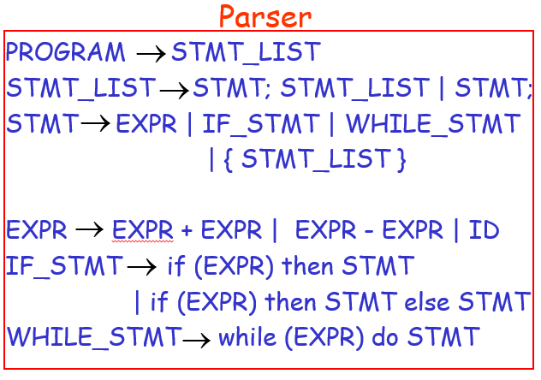
Parser

Slide 8
Parser
The parser finds the derivation of a particular input
derivation
Parser
input
E => E + E
=> E + E * E
=> 10 + E*E
=> 10 + 2 * E
=> 10 + 2 * 5
E -> E + E
| E * E
| INT
10 + 2 * 5
8

Slide 9
Parser
derivation tree
derivation
E
E => E + E
=> E + E * E
=> 10 + E*E
=> 10 + 2 * E
=> 10 + 2 * 5
+
E
E
10
E
*
E
2
5

Slide 10
Parser
derivation tree
E
machine code
E
+
E
mult a, 2, 5
add b, 10, a
10
E
*
E
2
5

Slide 11
Parsing
Parser
input
string
grammar
derivation

Slide 12
Example
Parser
derivation
input
?

Slide 13
Exhaustive Search
Phase 1:
Find derivation of
All possible derivations of length 1

Slide 14
Exhaustive Search

Slide 15
Phase 2
Phase 1

Slide 16
Phase 2
Phase 3

Slide 17
Final Result of Exhaustive Search
Parser
input
derivation

Slide 18
Time complexity of Exhaustive Search
Suppose there are no productions of the form
Number of phases for string :

Slide 19
Time complexity of Exhaustive Search
For grammar with rules
Time for phase 1:
possible derivations

Slide 20
Time complexity of Exhaustive Search
Time for phase 2:
possible derivations

Slide 21
Time complexity of Exhaustive Search
Time for phase :
possible derivations

Slide 22
Time complexity of Exhaustive Search
Total time needed for string :
phase 1
phase 2
phase 2|w|
Extremely bad!!!

Slide 23
S-grammars
There exist faster algorithms for specialized grammars
S-grammar:
symbol
String of variables
Pair
appears once

Slide 24
S-grammars
S-grammar example:
Each string has a unique derivation

Slide 25
S-grammars
In the exhaustive search parsing there is only one choice in each phase
Time for a phase:
Total time for parsing string :

Slide 26
S-grammars
For general context-free grammars:
There exists a parsing algorithm that parses a string in time

Slide 27
Summary
A parser knows the grammar of the Programming language
The parser finds the derivation of a particular input
There exist faster algorithms for specialized grammars

